Slide 1
Marketing Lecture # 1 Muhammad asad Instructor department of computer science

Slide 2
COURSE OVERVIEW
- Marketing under the category of management sciences courses. Course designed to teach students, as a supporting subject for their bachelor degree program.
- This course is designed to provide you the foundations of marketing --- Whether you plan to work in field of the marketing or not.
- Completion of this course, the students should able to know the basic skills required to succeed in today’s competitive environment.

Slide 3
Key Learning Point :-
- Discussion about marketing concept

Slide 4
There are the best
I always eat there
I only fly that with that airline
I buy my electronics at that store
I will prefer to go in that school

Slide 5
WHAT IS MARKETING
“The process of creating consumer value in the form of goods, services or ideas that can improve the target consumer’s life”
Marketing is more than selling and advertising as is perceived.
Identifying and satisfying customers needs.
Range of tasks and activities (Marketing mix 4 P’s --- Product, price, place and promotion).

Slide 6
MARKETING MIX (4 P’s)
PRODUCT — What are you selling? (It might be a goods or a service)
PRICE — What is your pricing strategy?
PLACE or DISTRIBUTION — How are you distributing your product to get it into the marketplace?
PROMOTION — How are you telling consumers in your target group about your product?

Slide 7
PETER DRUCKER
Goal of all organizations is to gain and retain customers --- Innovation and marketing are the only two ways to achieve the goal --- The rest only adds the cost.

Slide 8
In simple words marketing is…
Having the right product --- Available in the right place at the right time --- And --- Making sure that the customer is aware of the product.

Slide 9
SIMPLE MARKETING SYSTEM

Slide 10
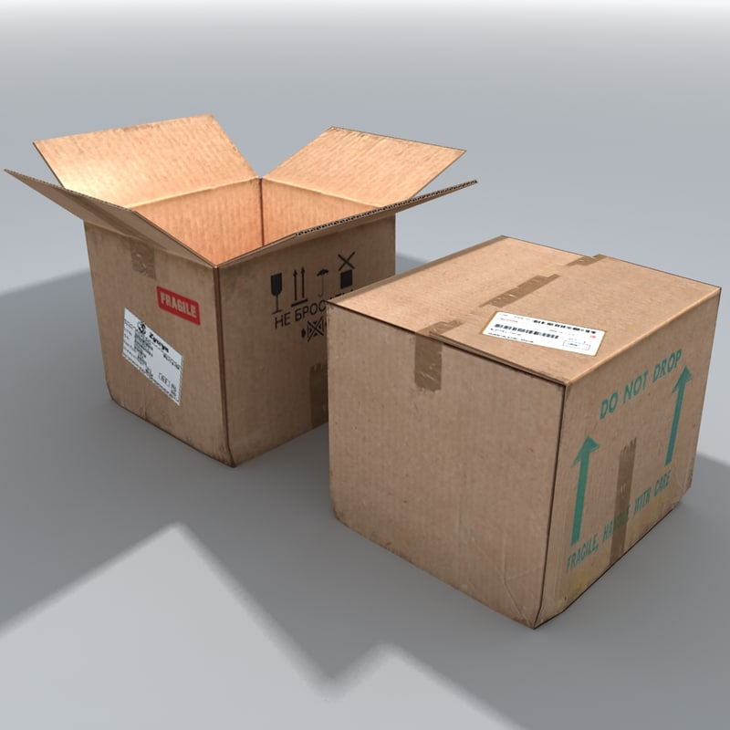





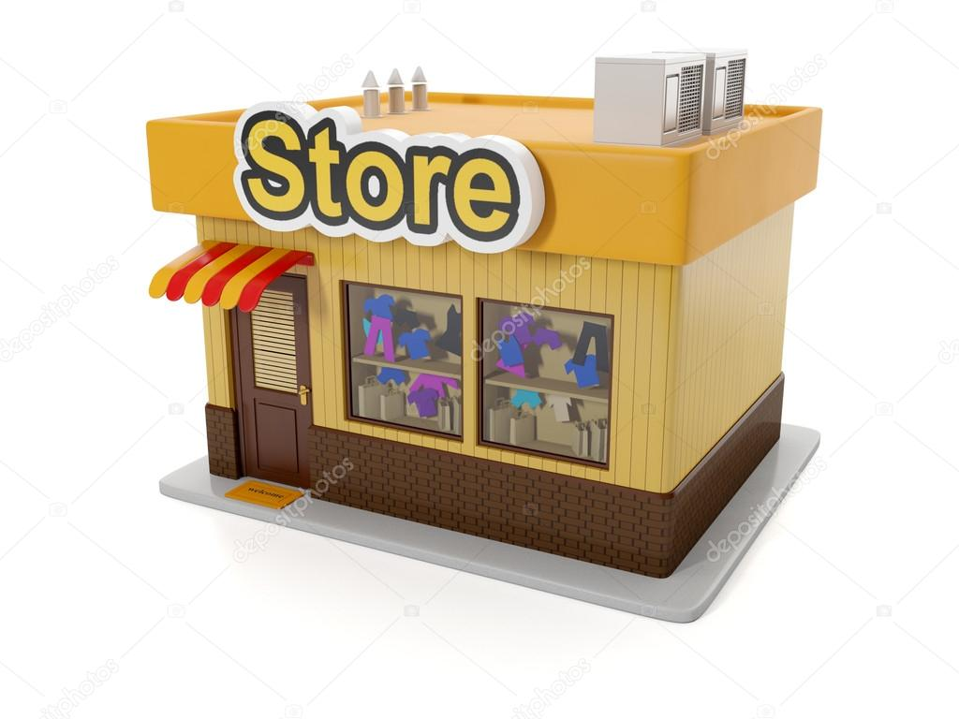
COMMUNICATION
GOODS & SERVICES
CASH
CONSUMER
&
BUYER
PRODUCER
&
SELLER
FEEDBACK

Slide 11
HOW DOES AN ORGANIZATION CREATE A CUSTOMER?

Slide 12

Identifying customer needs
Designing goods and services that meet those needs
Communicating information about those goods and services to prospective buyers
Making the goods or services available at times and places that meet customers’ needs
Pricing goods and services to reflect costs, competition, and customers’ ability to buy

Slide 13
WHAT DO MARKETERS THINK ABOUT?
(OPEN A BOOK SHOP ON CAMPUS)

Slide 14


Is there a need?
(Of having book shop)
What is my target market?
(Who will be buying products from your book shop)
What is my product?
(Basic items to be sold)
How can I produce and deliver a “product” better than my competitors?
How shall I promote my product?
How can I ensure customer loyalty?

Slide 15
MARKETING VS SELLING
We use the terms marketing and selling synonymously. However, it is important to understand the differences between marketing and selling.
Selling concept itself is a part of the marketing concept, marketing concept includes a number of activities like identifying the needs of customers, designing and developing the product as per their wants, fixing prices, encourage the buyers to buy the product.

Slide 16
SELLING
Selling is seller oriented approach --- Aims to capture market share and profit maximization.
The business assumes that consumers are waiting for its products --- and --- Once production is over, the sales force must sell everything using aggressive sales methods.

Slide 17
MARKETING
Marketing approach is buyer-oriented. It covers a broader range of activities that include the entire process…
Market research - to uncover customer needs.
Product planning and development – to make products that meet and satisfy customer needs.
Packaging, advertising and promotion – to create awareness and for brand-building.
Pricing and distribution – for long term revenue generation
In short, the purpose of marketing and sales is to increase revenue — marketing intentions at creating value for the customer and sees the customer as the reason for its existence.

Slide 18

ANY QUESTION
You can contact me at: asadali@uosahiwal.edu.pk
Your query will be answered within one working day.

